Slide 1



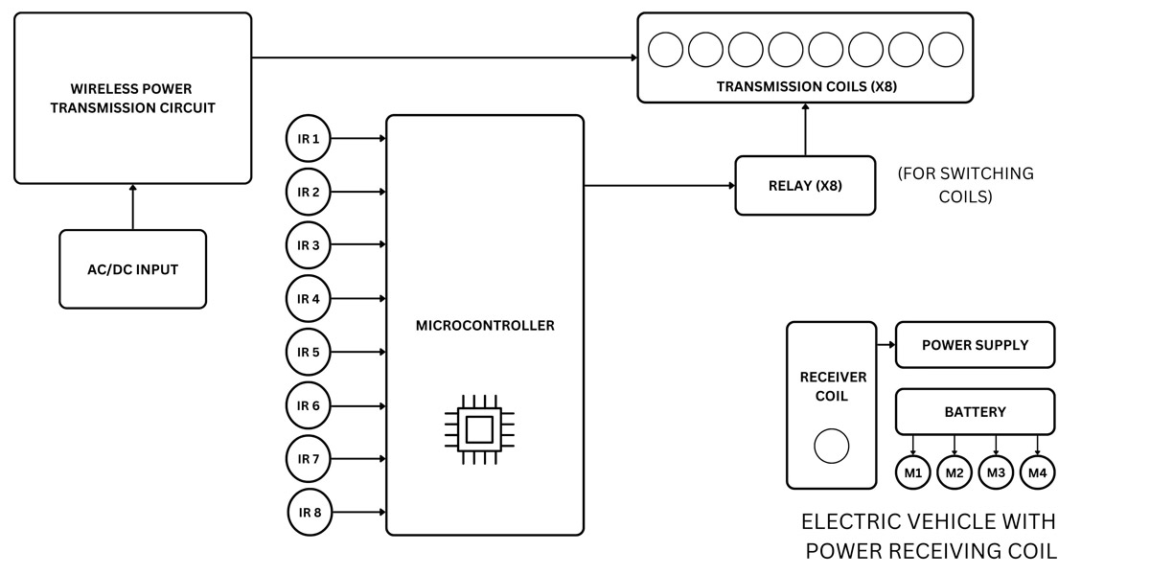
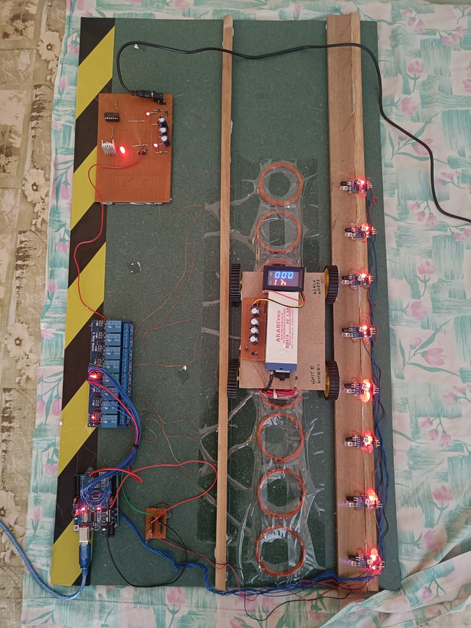
DKTE Society's Textile and Engineering Institute, Ichalkaranji
Title: On-Road Wireless Charging System
Authors: Avinash Masal, Manoj Kumbhar, Gourav Jalan
Project Guide: Prof. V. B. Sutar
Department of Electronics & Telecommunication Engineering, Textile and Engineering Institute, Rajwada, Ichalkaranji, India.
An Autonomous Institute
Project Category: Hardware
Project Field :
Application : Wireless Charging
INTRODUCTION
The eco-friendly vehicle is the global trend in the automobile industry.
The electrical vehicle (EV) is the most suitable alternative of petroleum vehicles.
SOFTWARE IMPLEMENTATION
To implement a software and simulation of a
On Road Wireless Charging System, several
points need to be consider :
Choose the appropriate hardware components
Develop the software.
Simulate the system
Test the system
Refine the system
ABSTRACT
The wireless charging method with the use of wireless power transfer is one of the best ways to use instead of petroleum vehicles.
The work is based on the concept of wireless power transfer.
The On-road wireless charging system overcomes the limitations of wired.
SYSTEM BLOCK DIAGRAM & FLOWCHART
RESULTS
AIM AND OBJECTIVE
Aims of this project work are :
The aim of On-road wireless charging system for electric vehicles (EVs) is to provide a convenient and efficient method of charging EVs without the need for physical cables.
Start
Laptop
CONCLUSION
Arduino
Objectives of project work are :
Wireless Charging
To reduce the pollution
To reduce use of fuel
To reduce the dependency on traditional charging infrastructure
To reduce the need of multiple charging cables
To reduce the time required to charge the vehicle at the charging station
Multiple
Relays
Multiple IR Senors
Wireless Transfer System
We are able to implement the on-road wireless system by use of concept of wireless power transfer
Relay 1=HIGH
Yes
IR Sensor 1
No
Yes
IR Sensor 2
Coil
Relay
2=HIGH
No
Yes
REFERENCES
L. Hua, J. Wang and C. Zhou, “Adaptive electric vehicle charging coordination on distribution network,” IEEE Transactions on Smart Grid. IEEE, vol.5, pp. 2666- 2675, 2014.
Singh, sagolsem & hasarmani, totappa & holmukhe, rajesh. (2012). Wireless transmission of electrical power overview of recent research & development. International journal of computer and electrical engineering. 207-211. 10.7763/ijcee.2012.v4.480.
Relay n
IR Sensor n
HARDWARE IMPLEMENTATION
Microcontrollers Used : Arduino Uno
Component Used : IR Sensor, Digital Voltmeter, Car, Copper coil, Relay, IR Sensor, Lead Acid Battery, Motor, Mosfet, IC-CD4047BD
RESEARCH POSTER PRESENTATION DESIGN © 2015
www.PosterPresentations.com

